Slide 1
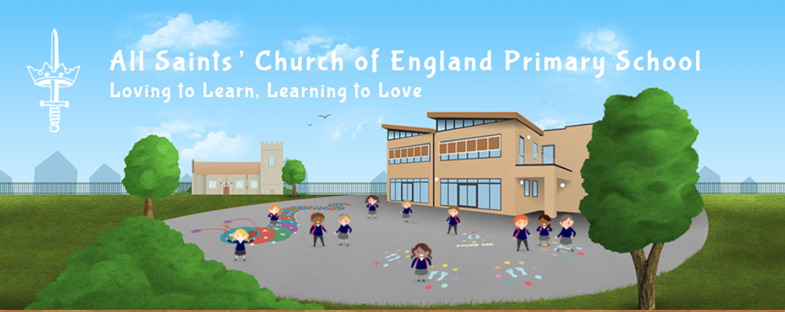
Phonics at All Saints Primary School

Slide 2
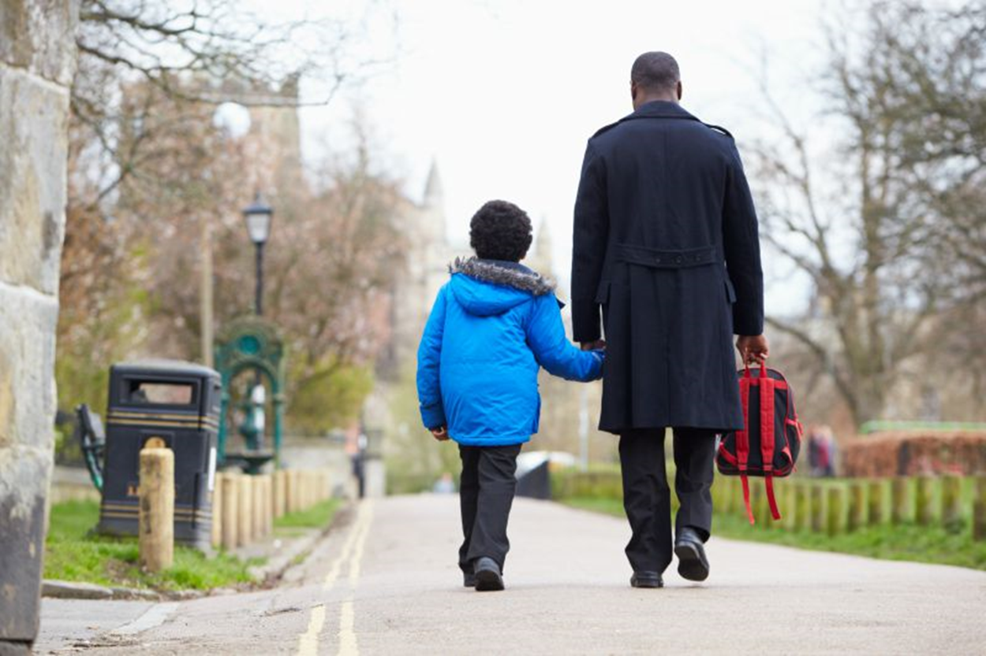
Parents and Carers
Your child loves learning about the world. Children can learn so much from spending time with you and talking to you.
You can help your child learn to read by reading with them, talking about books and supporting them with phonics.

Slide 3
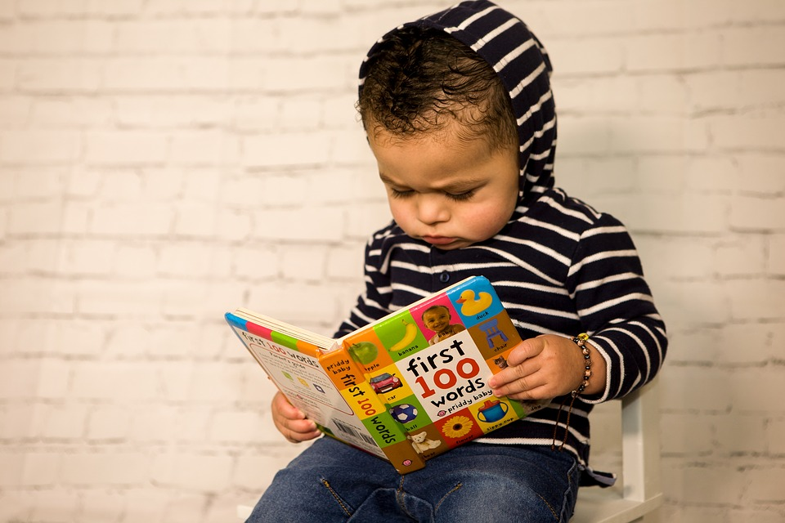
Reading is a skill which opens the door to a life of learning. A child who reads a lot will become a happy and confident reader.
There is no limit to learning if you can read!

Slide 4
Vocabulary
Phoneme – smallest unit of sound in a word.
Grapheme – a letter or sequence of letters that represents a phoneme.
Diagraph – 2 letters 1 sound (phoneme).
Trigraph – 3 letters 1 sound (phoneme).

Slide 5
What is phonics?
Phonics is the ability to convert a letter (grapheme) or letter groups (graphemes) into sounds (phonemes) that are then blended together to make word.
At All Saints Primary School, we are using the Read Write Inc (RWI) phonics programme to support children in their reading and writing.

Slide 6
Using phonics enables children to read words and sentences with increased accuracy, which means that they can then focus on understanding what they read.
It also allows them to spell with more confidence so that they can focus on the content of their writing.
The children are assessed every half term. They will work with a RWI trained teacher or teaching assistant.

Slide 7
Phonemes are taught in three progressive stages
Set 1 sounds: m a s d t i n p g o c k u b f l h sh r j v y w th z ch qu x ng nk
Set 2 sounds: ay ee igh ow oo ar or air ir ou oy
Set 3 sounds: ea oi a-e i-e o-e u-e aw are ur er ow ai oa ew ire ear ure
Once a child has been introduced to a new sound, the sound is revisited and practised frequently.

Slide 8
Blending to Read
Set 1 sounds are primarily individual letters (graphemes).
Towards the end of set 1 children are introduced to the concept of blending sounds to read and segmenting words to spell.
Blending is a vital skill for reading
The separate sounds (phonemes) are spoken aloud, andin order, all through the word, and are then merged together into the whole word.
s--t = sit
Here is a You Tube example of the simple blending of sounds: https://www.youtube.com/watch?v=nZjmEQfugT8

Slide 9
Phonemes
Children will learn the phonemes (sounds) for a number of letters (graphemes)
They will also learn that some phonemes are made up of more than one letter, for example ‘ew’
We use rhymes to help to remember the phonemes, for example
ew: chew the stew
Digraphs - two letters = one sound eg: ea cup of tea
Trigraphs – three letters = one sound eg: igh as in high

Slide 10
Can you use the phoneme frame to work out how many sounds there are in these words?
sun | s | u | n
bird
shop
boys
chill
this
dash
thick
path

Slide 11
Segmenting to spell
Segmenting to spell is where the whole word is spoken aloud and then broken up into its sounds (phonemes) in order, through the word.
hop = h-o-p
As children progress through the stages they gradually become aware of the different graphemes that make the same sounds are not taught until key stage 1.
For example ay (may I play)
ai (snail in the rain)
a-e (make a cake)

Slide 12
During each phonics session your child will also learn to:
read all the letter names in the alphabet and how to form them correctly.
read more tricky words and begin to spell some of them.
read and write words in phrases and sentences.

Slide 13
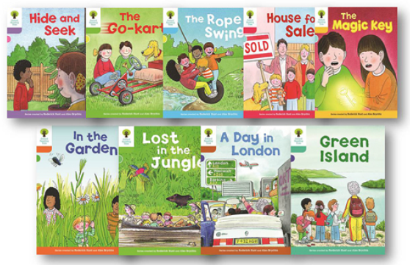
Individual Reading Books
You can help your child spot different phonemes in their reading book!
Enjoy bedtime stories together, spend time talking about books and stories.

Slide 14
Useful websites and online resources and information
http://www.letters-and-sounds.com/
https://www.gov.uk/.../Letters_and_Sounds_-_DFES-00281-2007.pdf
http://www.phonicsplay.co.uk/
https://www.youtube.com/watch?v=Djz82FBYiug

